Slide 1

Serena Hodgson
Age: 24
Occupation: Student who just graduated college and has an Accounting degree
Skills: Good with numbers, organization, knows how to use technology, is able to adapt to new challenges, knows how to work in teams, written and verbal communication, efficient
Frustrations: Losing time doing things that are unnecessary, having a lot of work and not having enough time to finish all and working with lazy people
“Do one thing every day that scares you”

Slide 2
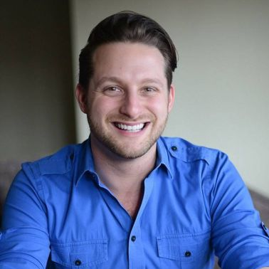
Alfred Rodriguez
Age: 34
Occupation: Architect who runs a firm
Skills: Continuous Learning, decision-making, interior design expert, programming, resilience and manages time between work and family
Frustrations: Wants things to get easier, having to work on the weekends, not having enough time to play with his children and having a mess at home
“We are what we pretend to be, so we must be careful about what we pretend to be”

Slide 3
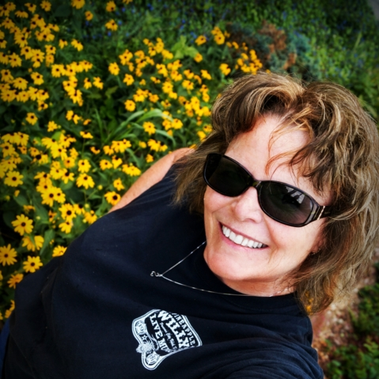
Dianne O'Quinn
Age: 55
Occupation: CEO of a multinational restaurant chain
Skills: critical thinking, business intelligence, teamwork, leadership and multi-tasking
Frustrations: Doesn’t know how to organize her work environment, not updated with technology, having to use a cane due to a medical problem and leaving her niece alone at home
“I'm not a chef. But I'm passionate about food - the tradition of it, cooking it, and sharing it”

Slide 4

James Bell
Age: 30
Occupation: Mechanic
Skills: Social, deductive reasoning, logical thinking, hard work, commitment and conflict management
Frustrations: People not being satisfied with his work, unorganized spaces, dirty workshop, being single
“The trick to having good ideas is not to sit around in glorious isolation and try to think big thoughts. The trick is to get more parts on the table”

